Slide 1
Building your first C# program
Hello World

Slide 2

DotNETFiddle.net

Slide 3
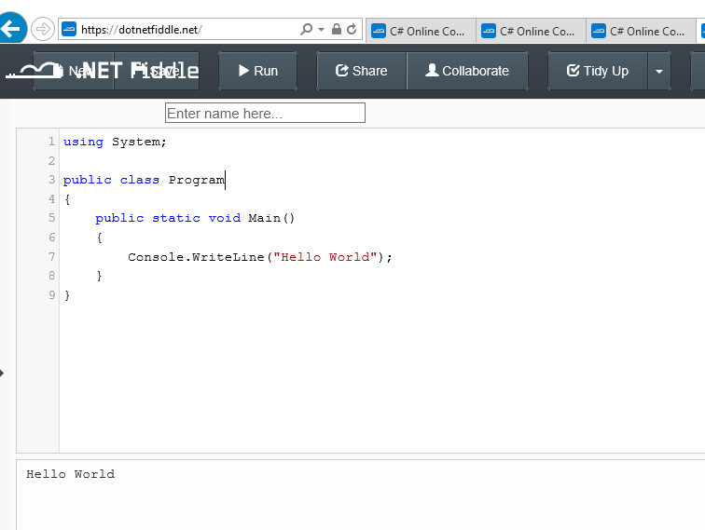

Slide 4
Running your C# Program

Slide 5
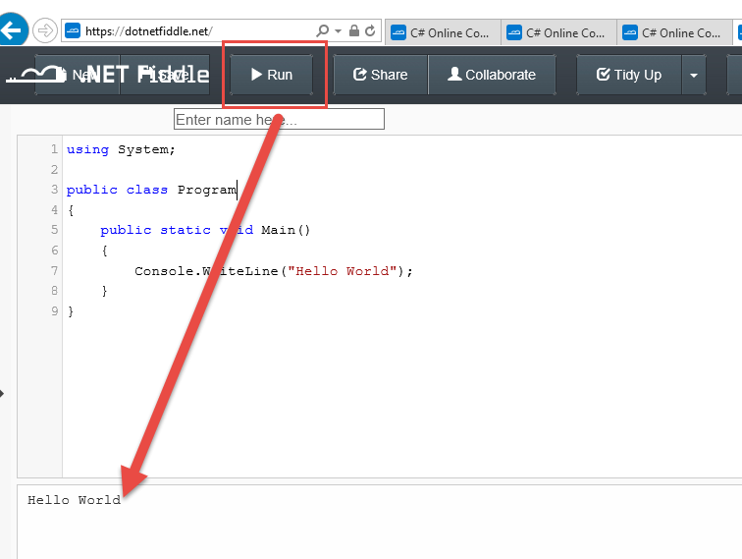
Click Run

Slide 6

Namespace and Class
Everything in C# must reside within a class
The basic construct of the type system.

Slide 7
Main – like Highlander, there can only be one
Main is the main entry point of a console application or Windows application.

